Slide 1

TALKON
PRESENTATION

Slide 2
Content
Overview
Understanding the problems
Project objective
Target audience
Key Features
Project timeline

Slide 3
Overview
We have created an android social media application known as TalkOn.
We choose the Android platform because it is easy to access and available everywhere.

Slide 4
Understanding the problems
01
Due to Covid-19 pandemic Social distancing is followed throughout the world Human to Human interaction is limited.
02
Data security is been not given most priority by different Social Media companies.
03
Privacy of the user is neglected.
04
PM Modi’s call for self reliant India( Atm nirbhar Bharat).

Slide 5
Project objective
To solve this problem we have created an MADE IN INDIA social media application and we will call it TalkOn.

Slide 6
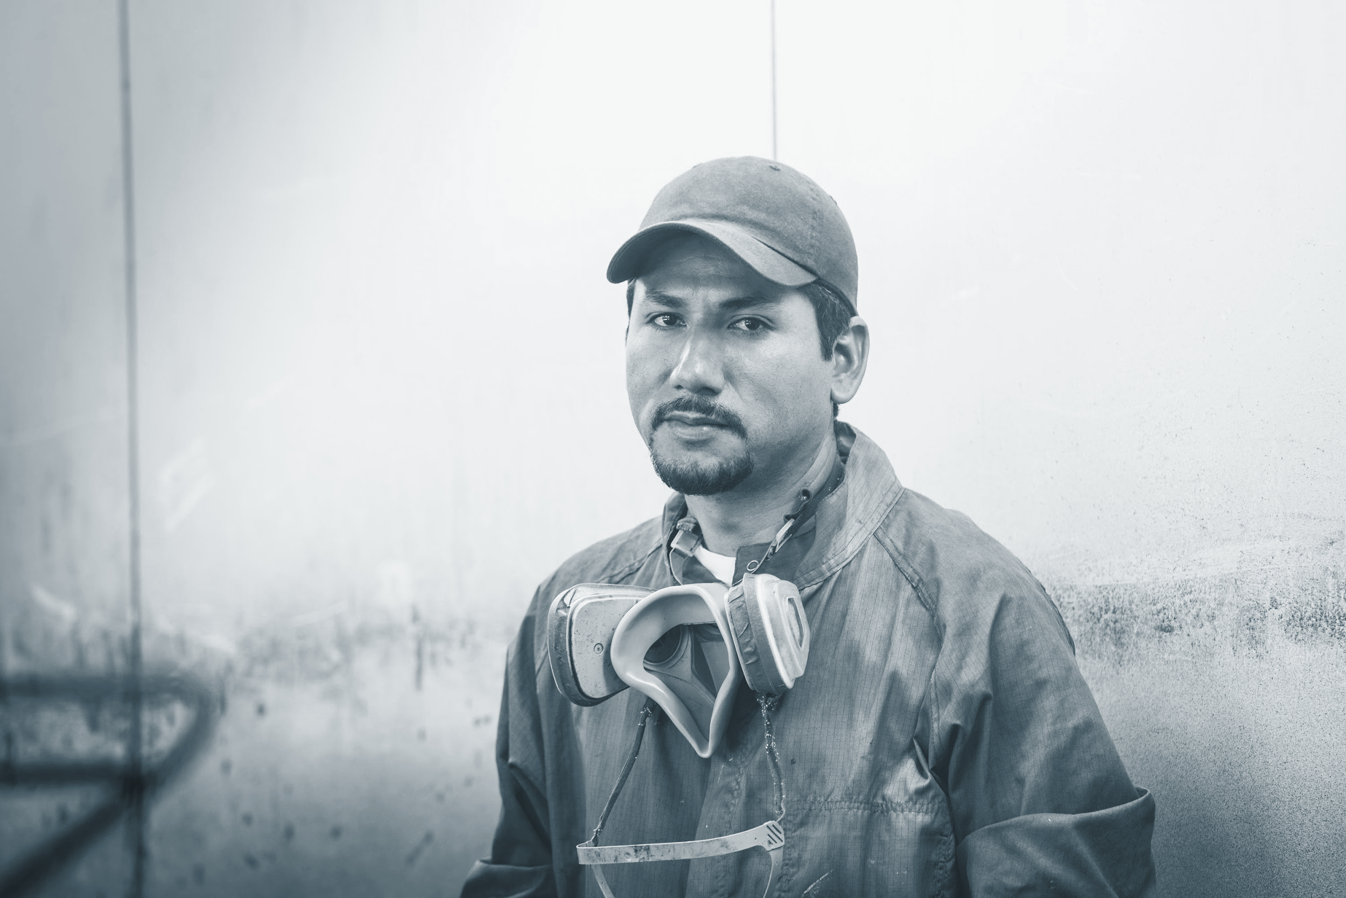


Target audience
All those individual how like interact with other people and like to live a socially active life.

Slide 7


Key Features
There are different features in TalkOn that make it an interesting social media application.
Some key features of this application are sign in ,log in , post , chat and many more.

Slide 8
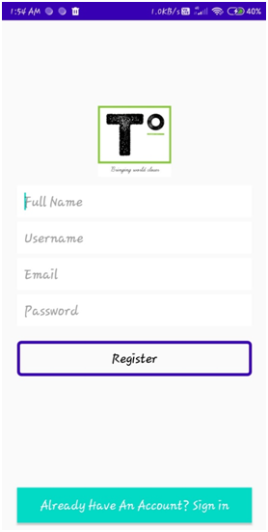
● Register / SignUp –
This is our application’s sign up page. From this page we can register our self-using the email id. Email id should be unique for every user.
The registered details will be stored in the Firebase Database. It will help us in future while log in. Because of the stored data, we will be able to log in any time using our email id.

Slide 9
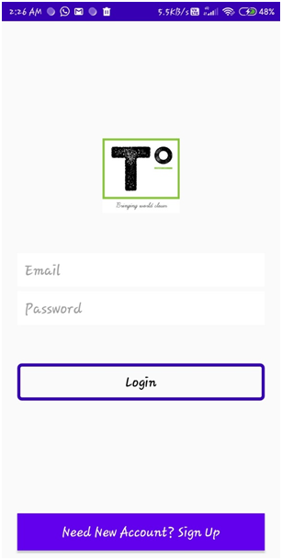
● Log In / Sign In –
This is our application Log in page. With this help, user can log in any time by entering the unique email address and its password
While registering, the user information was stored on Firebase Realtime Database. Through this Database we can check the details enter by the user while login. Here is the user interface of the log in page.

Slide 10
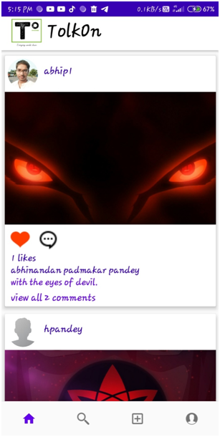
Home
With the help of home page, user can view the posts timeline of the people he is following and also itself.
Here, not only user can view, but here he or she has the facility of giving their response by liking the posts and commenting on them. Only friends can view user posts. No one else can view it.

Slide 11
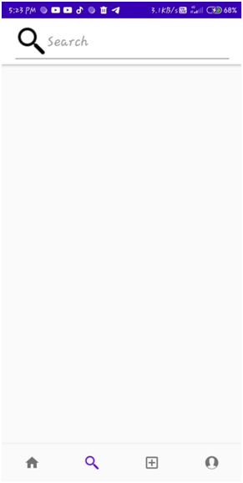
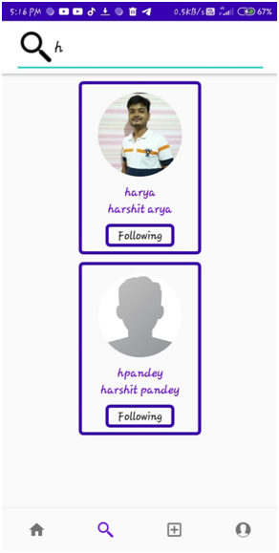
● Search –
Search Page is one of the best features of our application. With the help of this page, user is able to search other peoples with their usernames, which they provided at the time of registration.

Slide 12
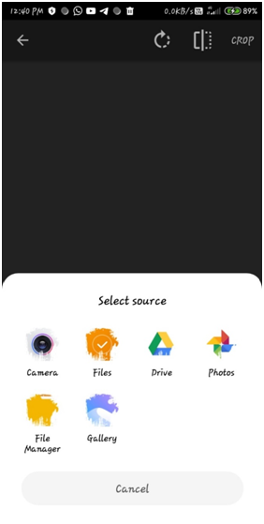
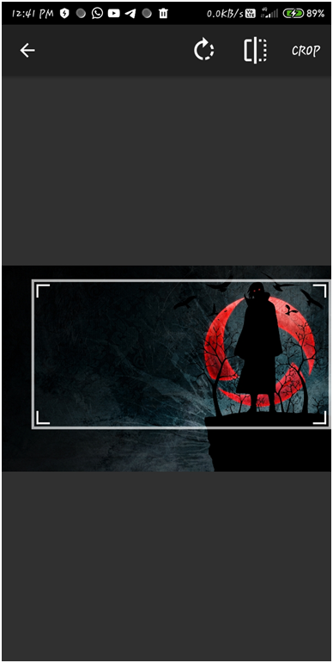

● Add post –
This is one of the main feature of our application. By clicking the add icon , user can directly jump to the Add Icon Page and can select the image.

Slide 13
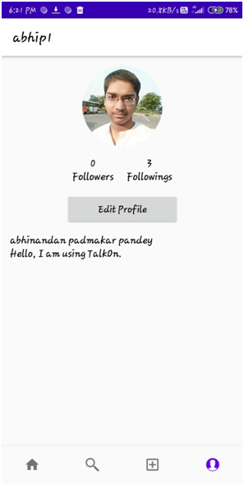
● Profile –
With the help of Profile Page, user has the ability to check the details they provided at the time of registering the account.
Here, user can also has the facility of changing the account details. User can change his or her Full name, username, and bio and also can change the profile picture.

Slide 14
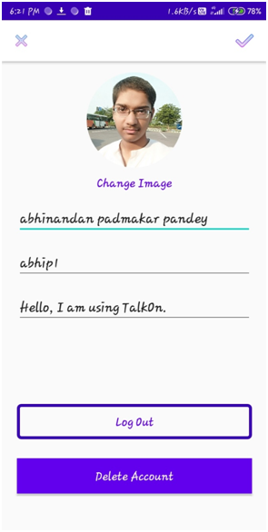
● Account Setting –
Account setting Page is one of our application main feature,
.With the help of it, user can change the details of its account any time he or she want.t.
This Account setting page also provide the facility of log out or you can say sign out and deleting the account.

Slide 15
Project timeline
JULY
AUG
SEPT
OCT
NOV
DEC
Project selected
Research
Learned Kotlin
Development
Final Submit
Presentation
Selected a project named it TalkOn
Gained knowledge about different technologies Firebase, API, Big Data
Gain knowledge about Kotlin language
Start working on the project TalkOn (Coding)
Final submission
Final Presentation and VIVA

Slide 16
Thank you!

